Slide 1
Session 5
NAD1001: INTRODUCTION TO ARCHITECTURAL DESIGN

Slide 3
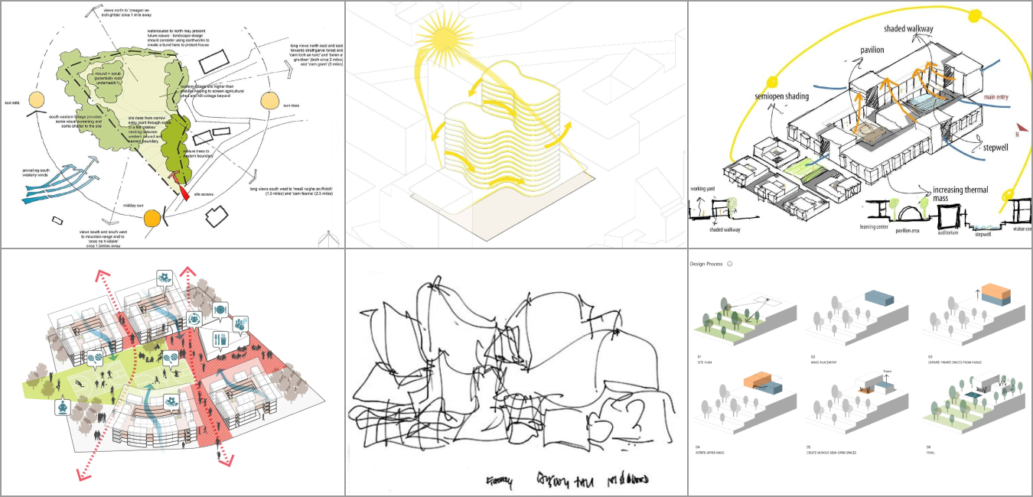
Quick Revision
We have learnt a lot about pre-design and initial design, including design principles, site analysis, site plan, precedent case study, concept and massing…
Now we are entering the sketch design/design development phase, where we can explore more design methods to refine the project…
Source: Pinterest

Slide 4

Design Method
Traditional vs. Modern: Traditional methods relied heavily on hand-drawing and physical models, while modern methods incorporate digital technologies.
Source: Pinterest

Slide 5
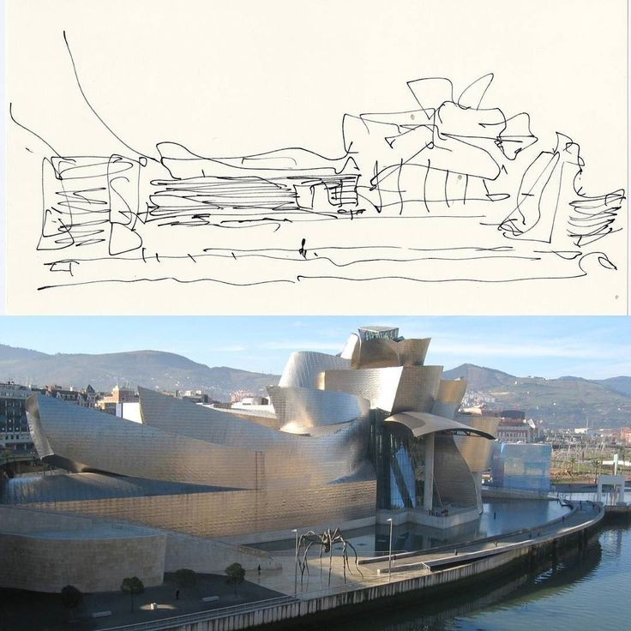
Conceptual Design
Brainstorming and ideation techniques.
Concept mapping and mood board with sketching.
Guggenheim Museum by Frank Gehry
Source: ArchDaily

Slide 6
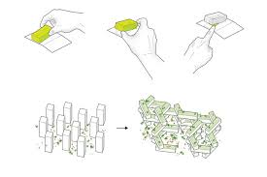
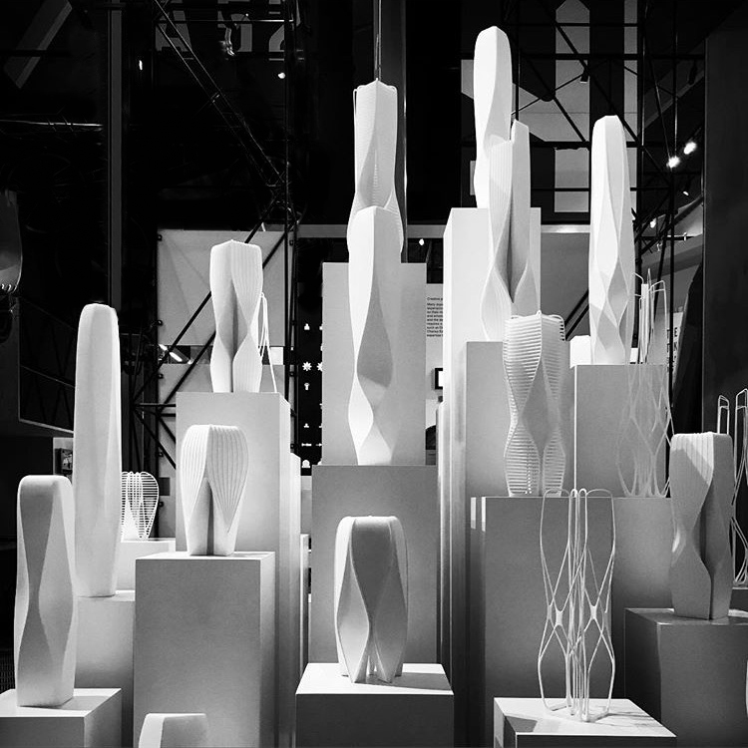
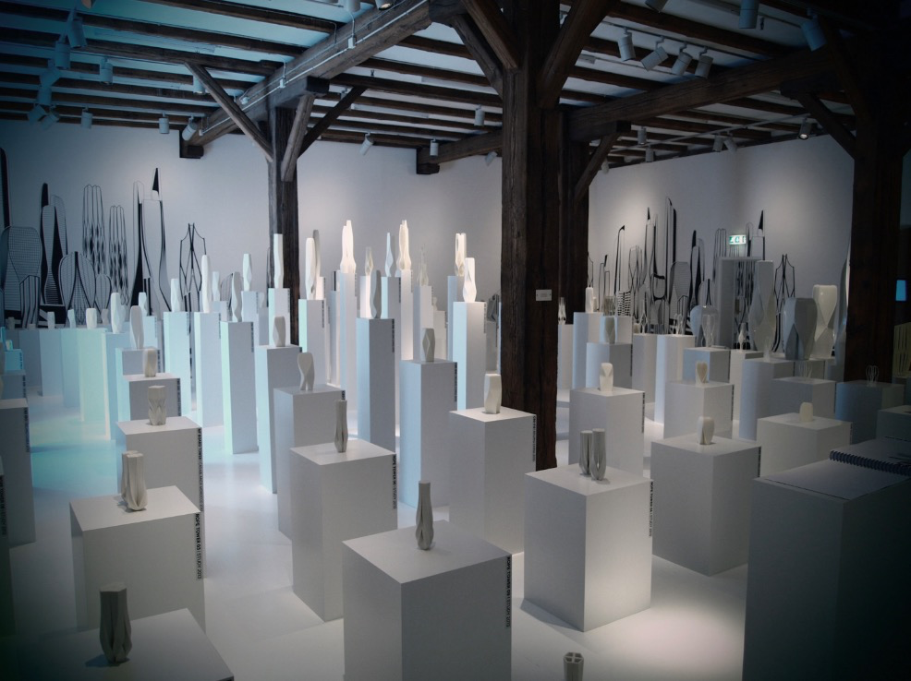
Design by Making
Design using model making as the primary tool.
Produce iterations of model and explore the design.
Zaha Hadid Design’s art installation on ‘City of Towers’ derives from a singular concept, the many possibilities and iterations for a tower are showcased, mapping its adaptations and development process.
Source: Pinterest and Zaha Hadid Architects

Slide 7
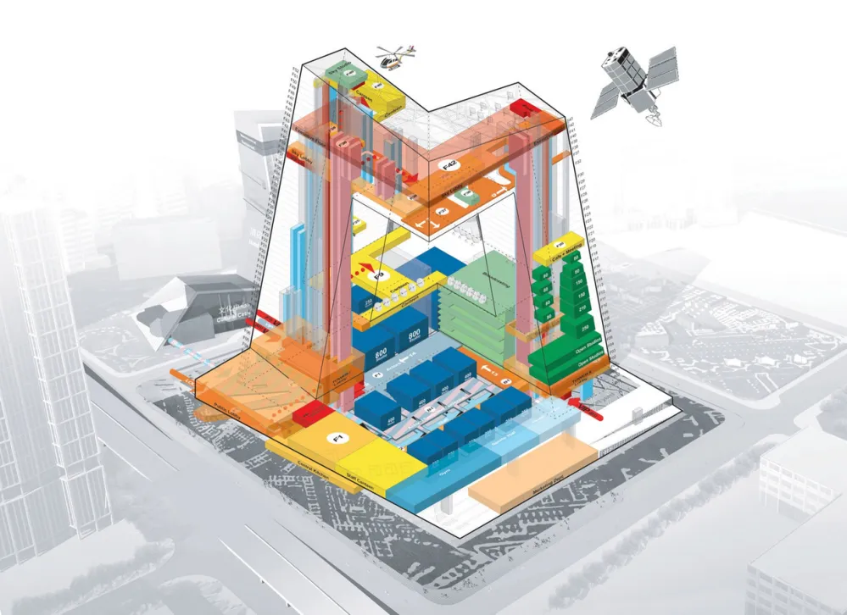
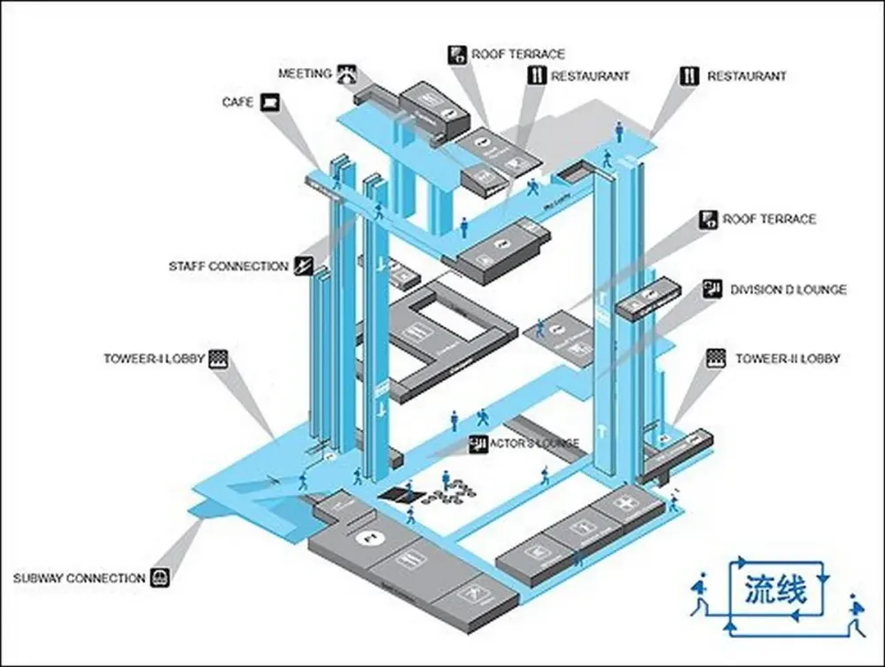
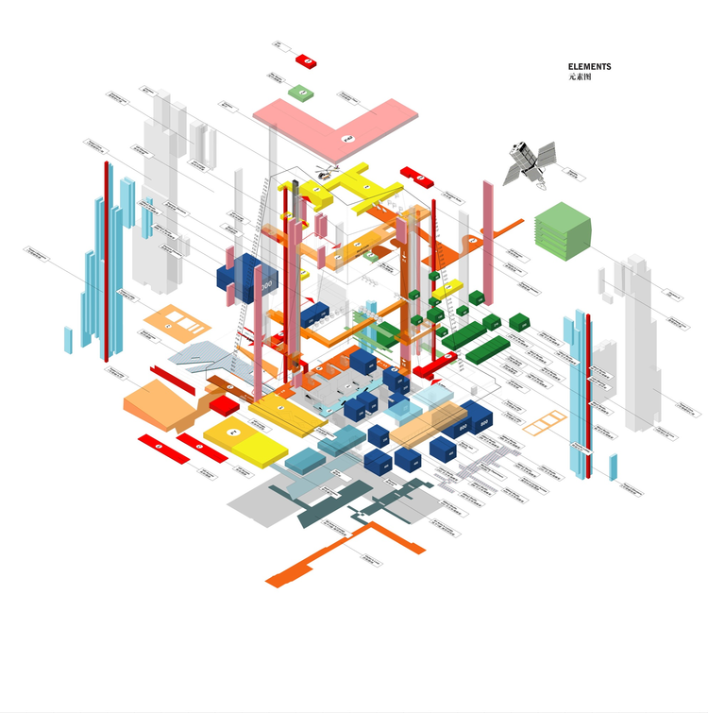
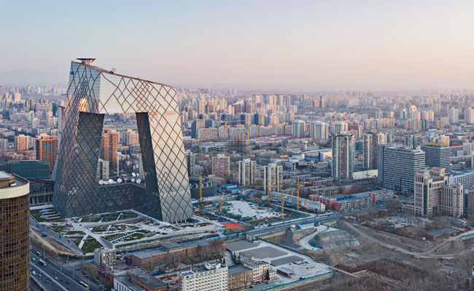
Analytical Design
Use of diagrams and flowcharts to analyse site and user data.
Strategically place and incorporate all functions within the building.
Source: OMA

Slide 8
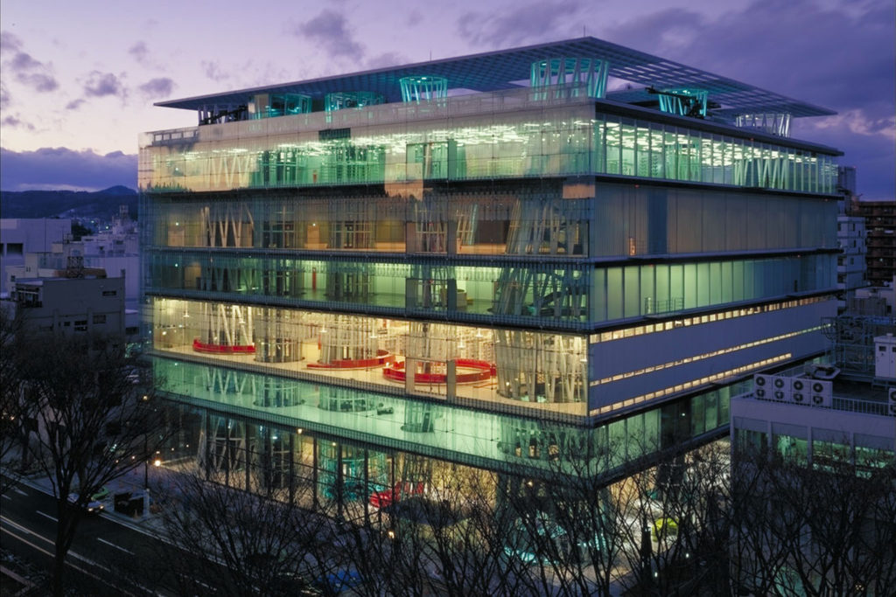
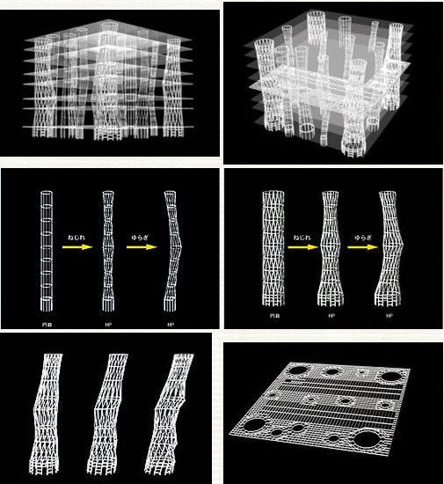
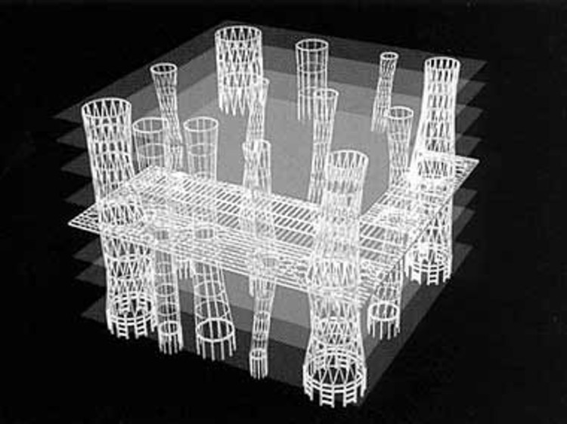
Computational Design
Parametric and algorithmic design for complex geometries and adaptive structures.
Simulation tools for energy modeling and structural analysis.
Sendai Mediatheque by Toyo Ito
Source: ArchDaily

Slide 9
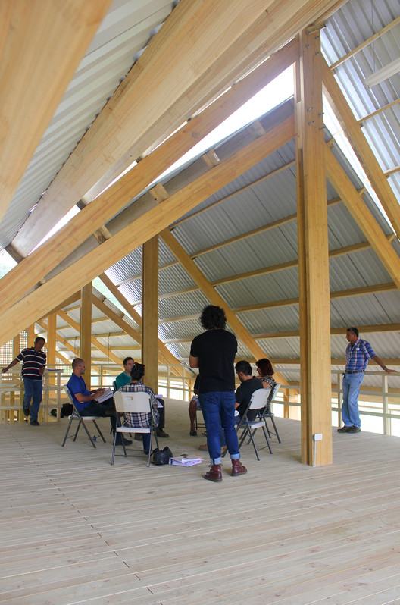
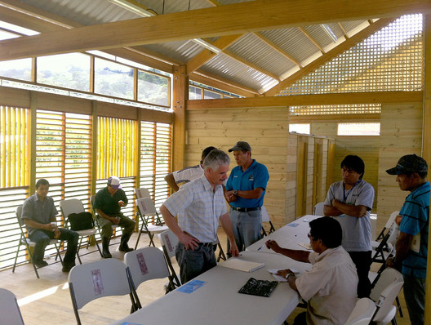
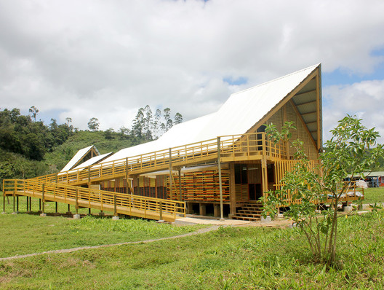
Participatory Design
Workshops and community engagement sessions.
Co-design practices that involve stakeholders in the design process.
The project for the Käpäcläjui Indigenous Training Center in Costa Rica emerged from a series of proposals following participatory design workshops. These activities were key in fostering a sense of belonging in the community when it came to visualizing and making decisions. It was an opportunity to understand and co-create spaces that were more coherent with their surroundings and centered on the user's needs.

Slide 10
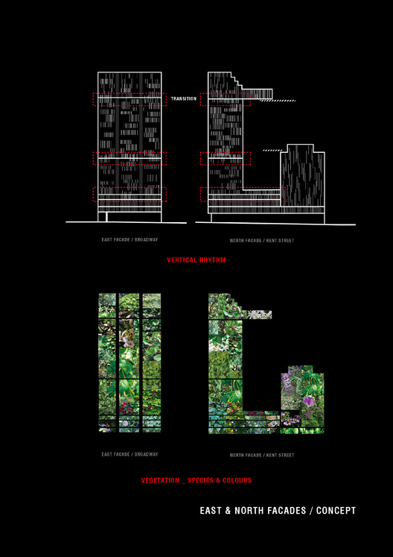
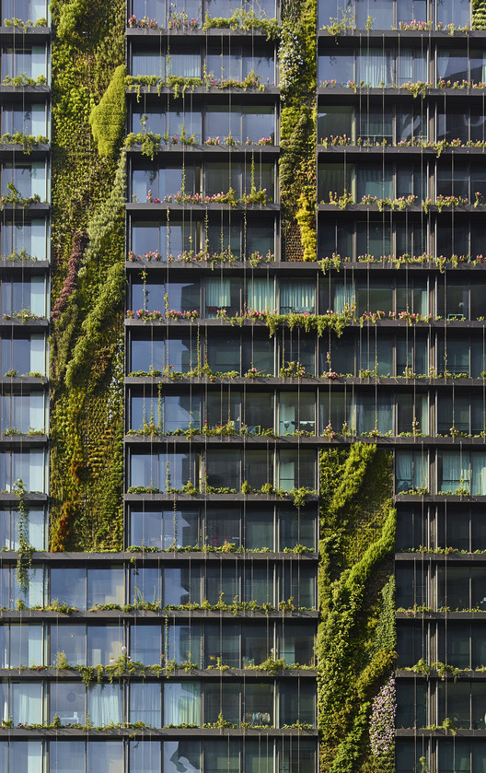
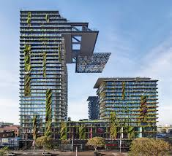
Sustainable Design
Principles of sustainable design: reducing environmental impact, enhancing efficiency, and prioritizing user comfort.
Techniques like passive solar design, green roofs, and sustainable material selection.
Certification systems like LEED, BREEAM, or Green Star.
One Central Park, Sydney by Jean Nouvel
https://www.archdaily.com/551329/one-central-park-jean-nouvel-patrick-blanc
Vertical Garden

Slide 11
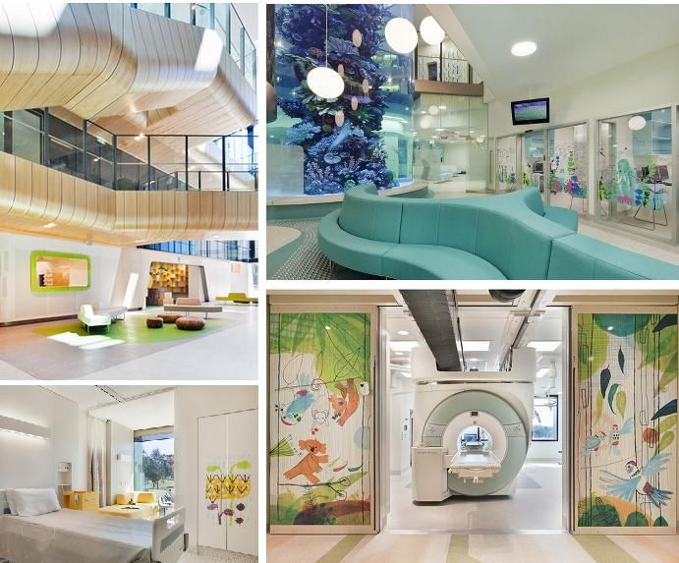
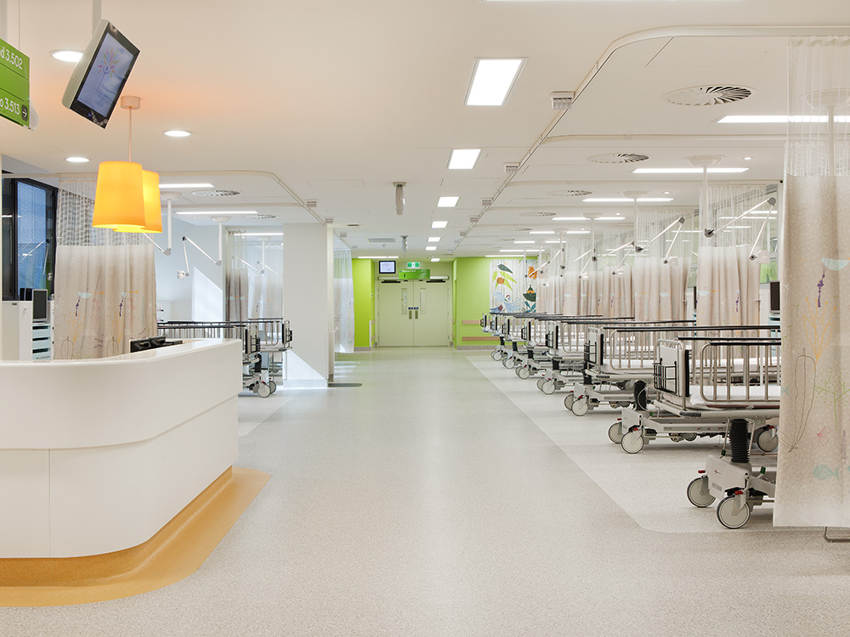
Evidence-Based Design
Involves making design decisions based on credible research to achieve the best possible outcomes.
Commonly used in healthcare architecture to improve efficiency and user experience.
The Royal Children Hospital

Slide 12
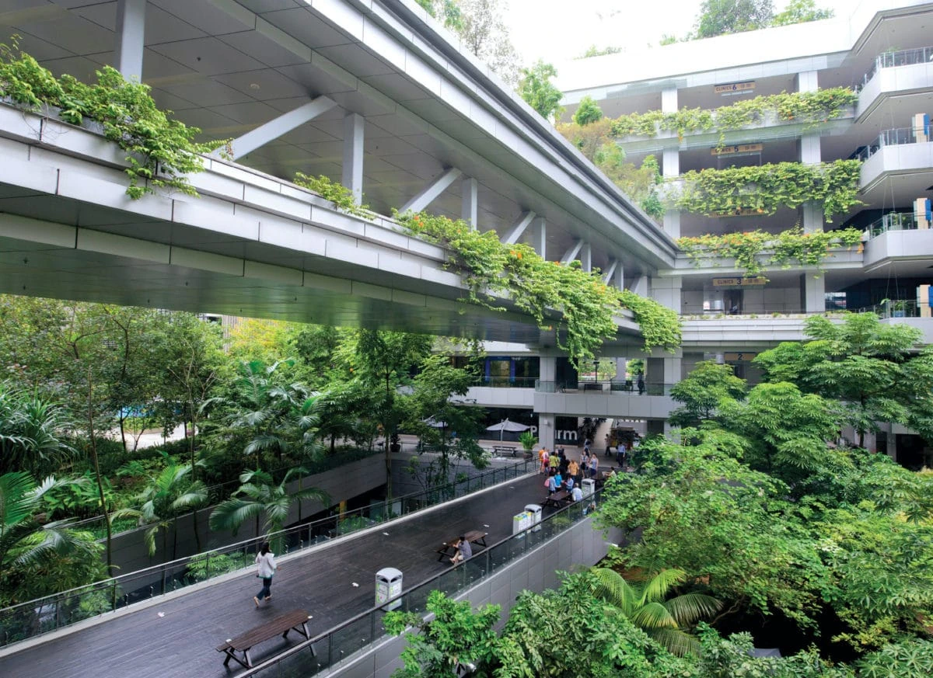
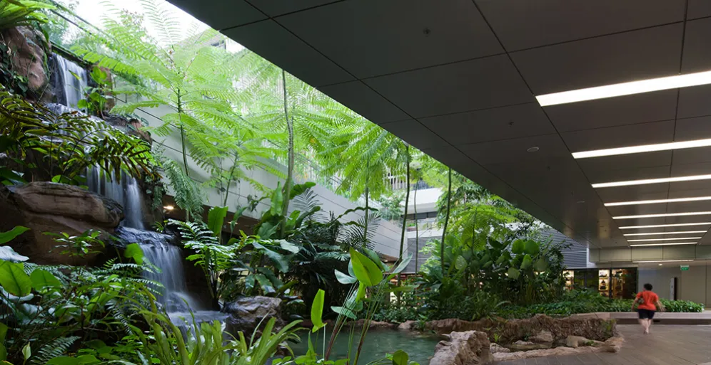
Biophilic Design
Focuses on incorporating natural elements into the design of the built environment to enhance human connection to nature.
Incorporating elements like natural lighting, vegetation, natural materials, and nature views to improve wellbeing.
https://gbdmagazine.com/singapore-hospital/
https://www.archdaily.com/923100/bringing-the-outdoors-inside-the-benefits-of-biophilia-in-architecture-and-interior-spaces?ad_campaign=normal-tag
Khoo Teck Puat Hospital in Singapore

Slide 13
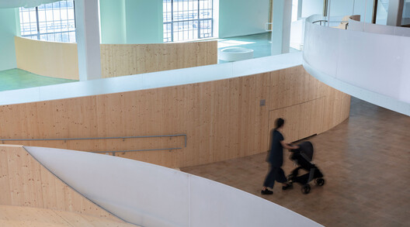
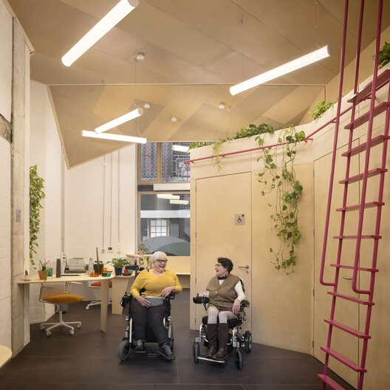
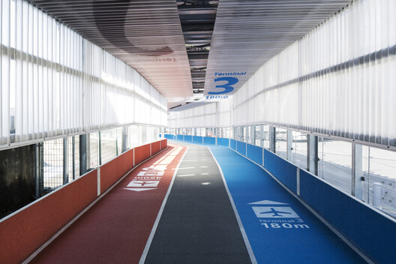
Universal Design
Designing buildings and environments that are accessible to all people, regardless of age, disability, or other factors.
Features that enhance accessibility, such as wheelchair ramps, braille signs, and multi-sensory environments for a diverse range of users.
https://www.archdaily.com/1019661/how-do-the-7-principles-of-universal-design-help-us-create-better-architecture?ad_campaign=normal-tag

Slide 14
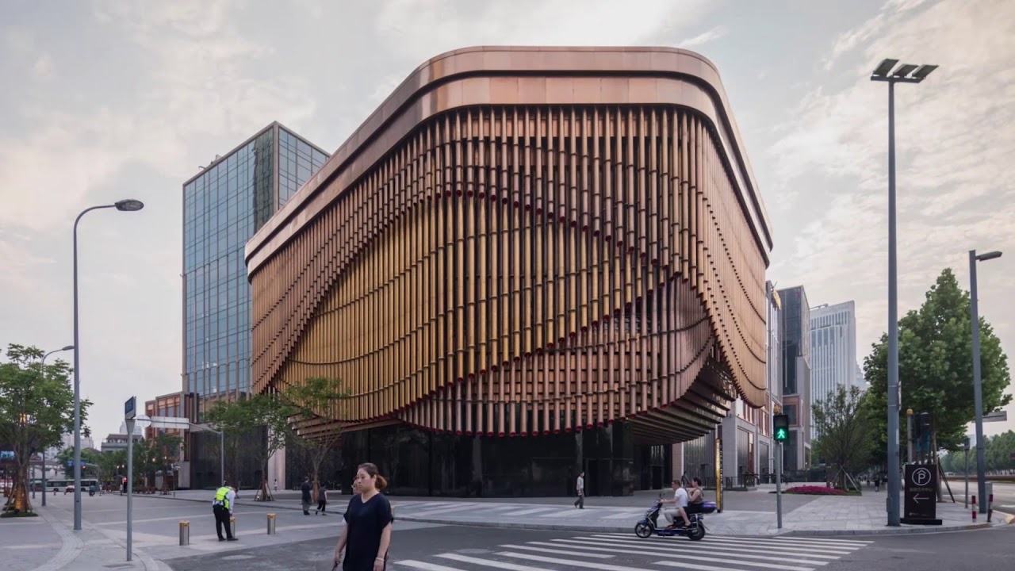
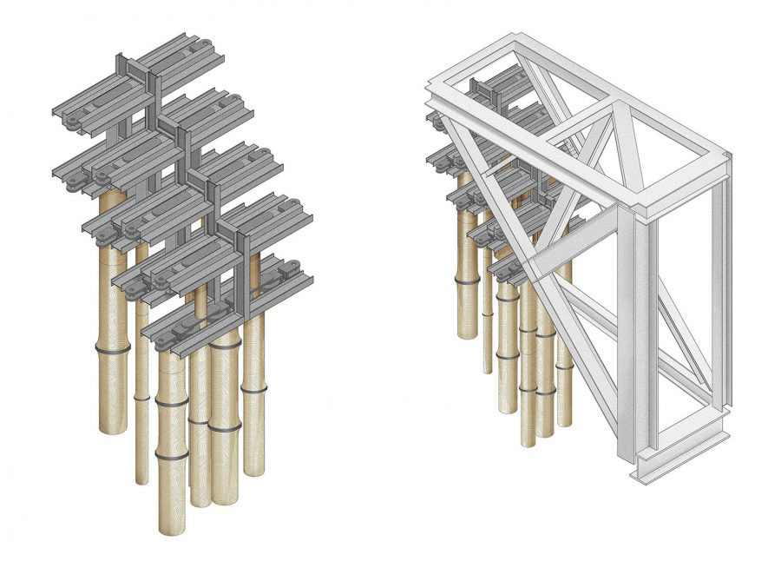
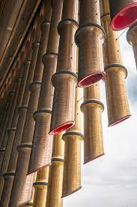
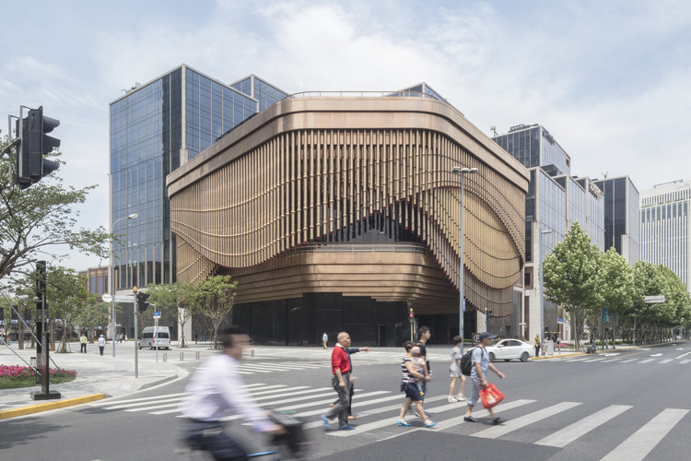
Kinetic Design
Designing buildings or building components that are capable of movement, adapting to changes and interacting with users.
Dynamic structures that change in response to environmental conditions, user needs, or aesthetic purposes, such as responsive facades and retractable roofs.
https://www.archdaily.com/881511/bund-finance-centre-foster-plus-partners-plus-heatherwick-studio
Bund Finance Center by Foster Partners and Heatherwick Studio

Slide 15
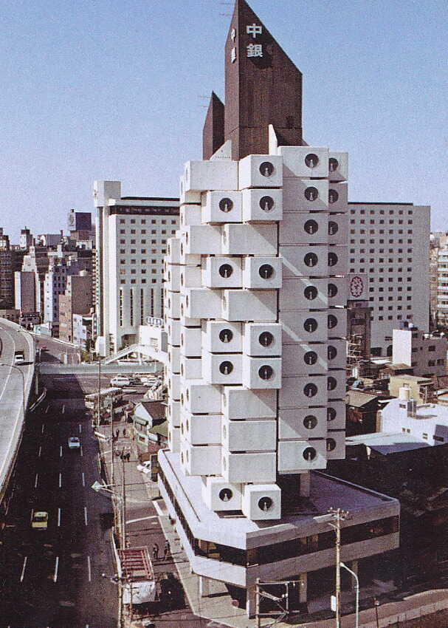
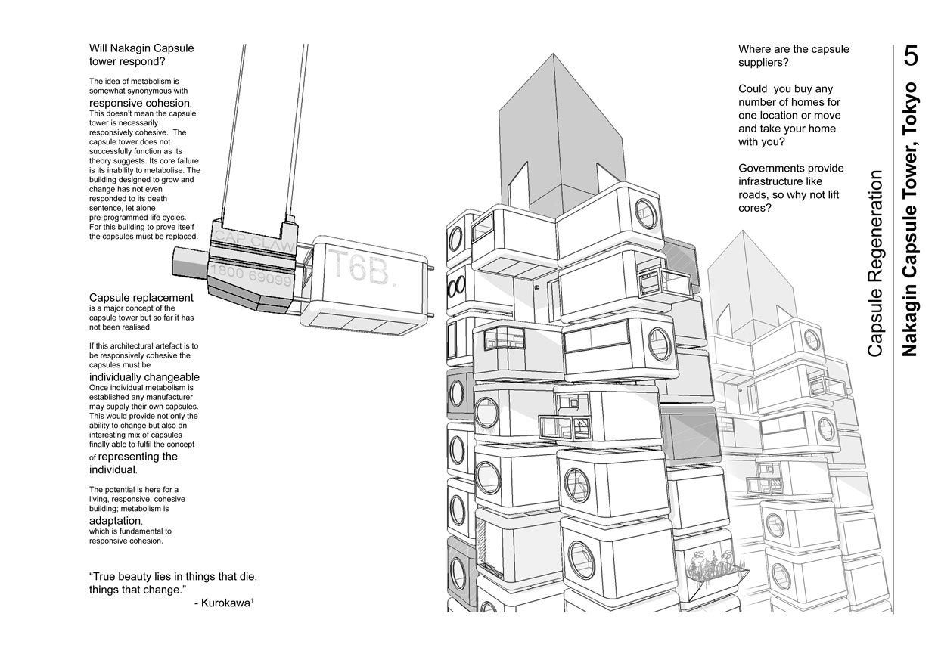
Modular Design
Involves designing using standardised units or dimensions for easy construction and flexible arrangement.
Particularly useful in projects requiring scalability or mass production, such as modular homes and office spaces.
Nakagin Capsule Tower in Japan

Slide 16
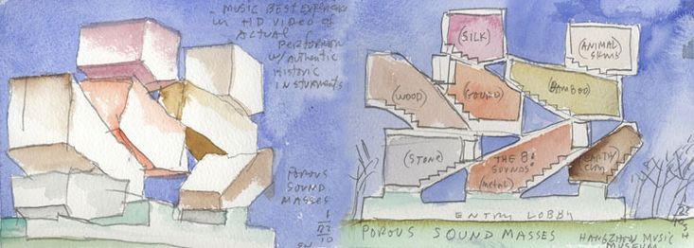
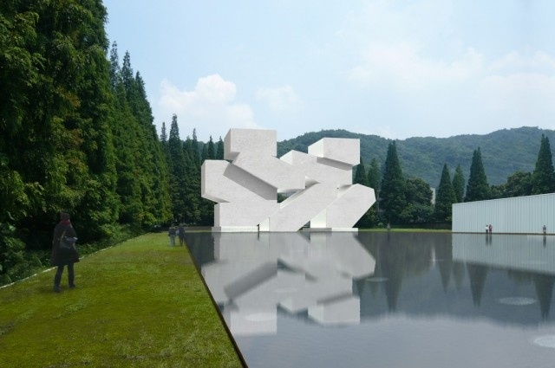
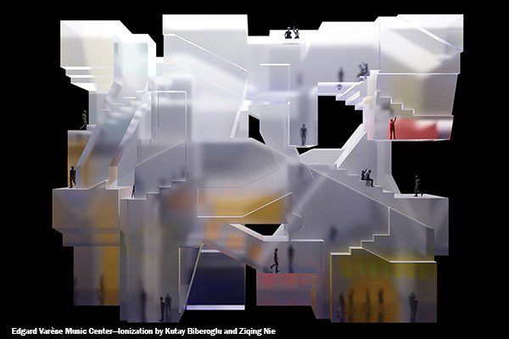
Experiential Design
Focuses on creating spaces that deliver specific sensory experiences or evoke particular emotions.
Common in retail and exhibition design where the interaction between the user and the environment is key to the project's success.
https://www.archdaily.com/925219/steven-holl-i-am-interested-in-architecture-that-speaks-to-the-soul
https://www.stevenholl.com/architectonics-of-music/
Architectonics of Music
Hangzhou Music Museum

Slide 17
Activity: Reflect on a Design Method

Slide 18
Session 5
Floor Plan

Slide 19
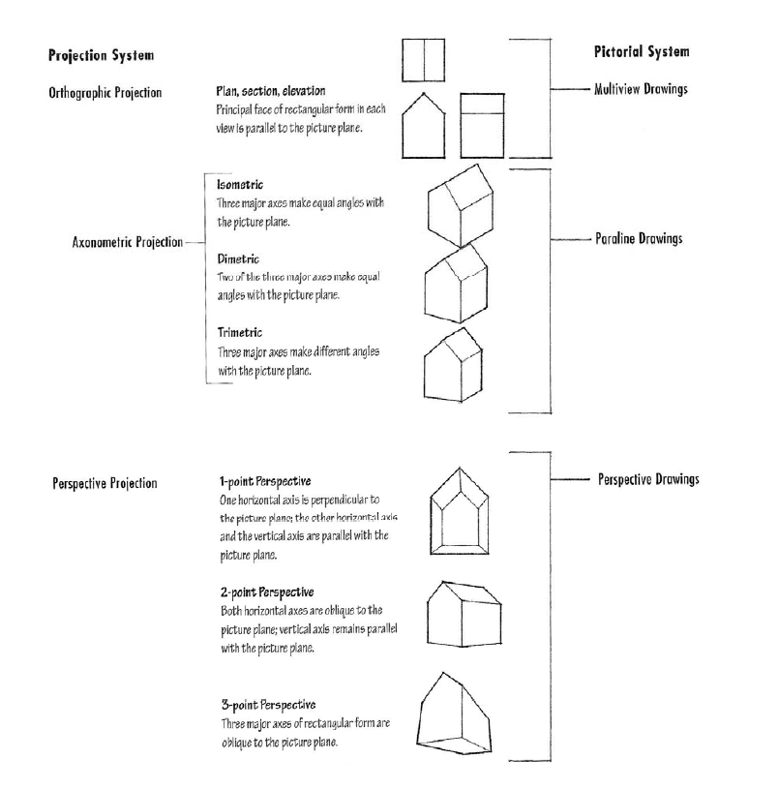
Floor Plan and Other Drawings
Source: Design Drawing by Francis D. K. Ching

Slide 20
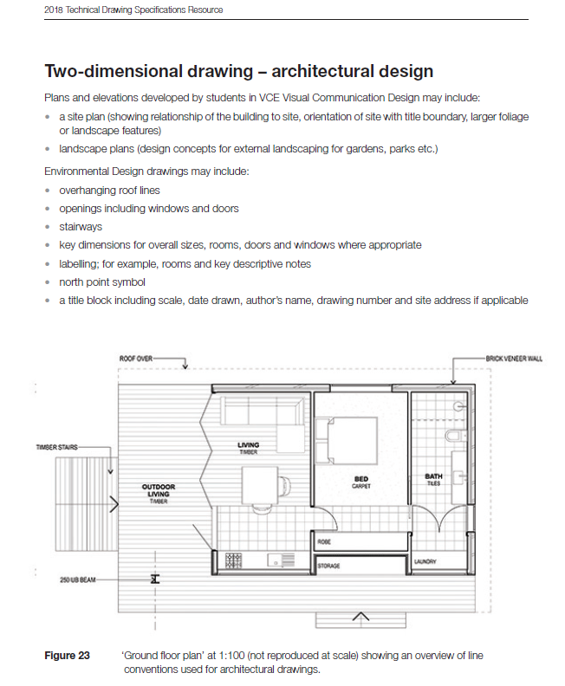
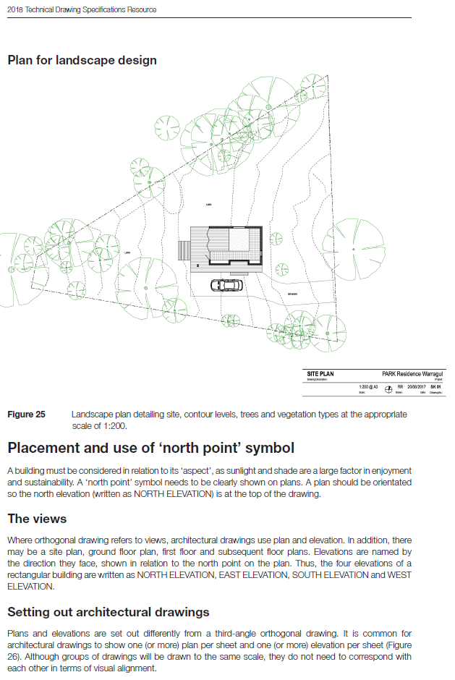
Source: VCE Technical Drawing Speciﬁcations

Slide 21
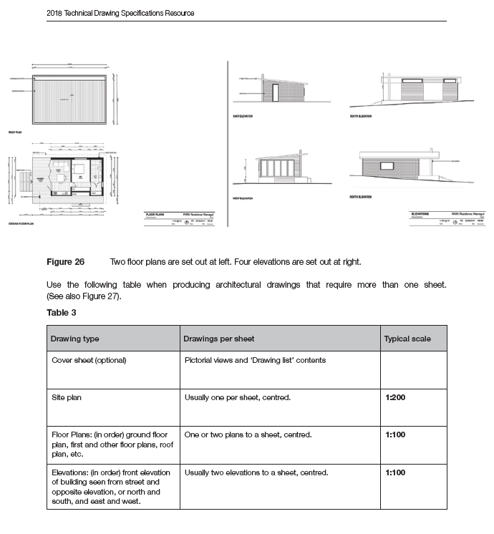
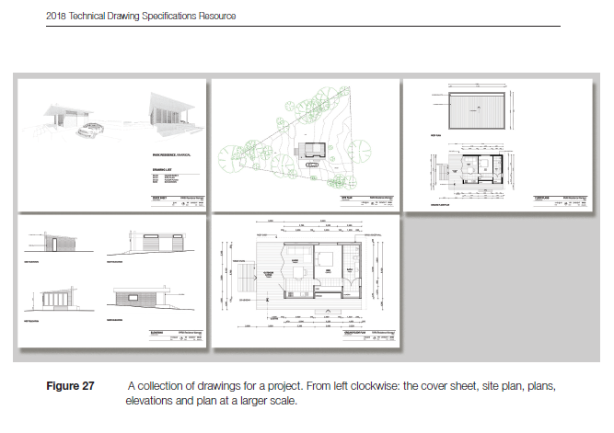
Source: VCE Technical Drawing Speciﬁcations

Slide 22
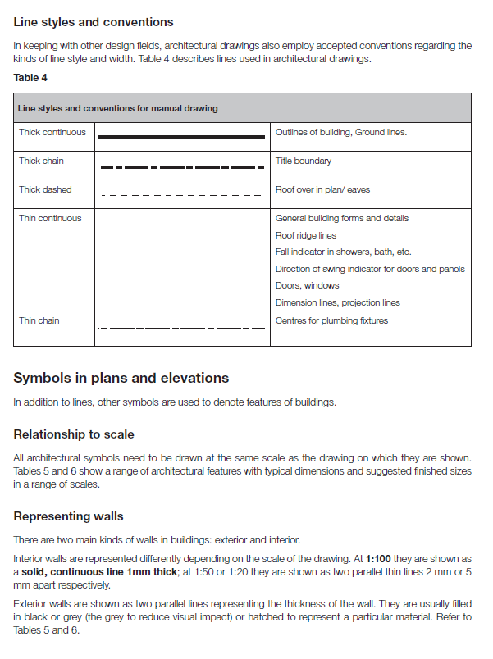
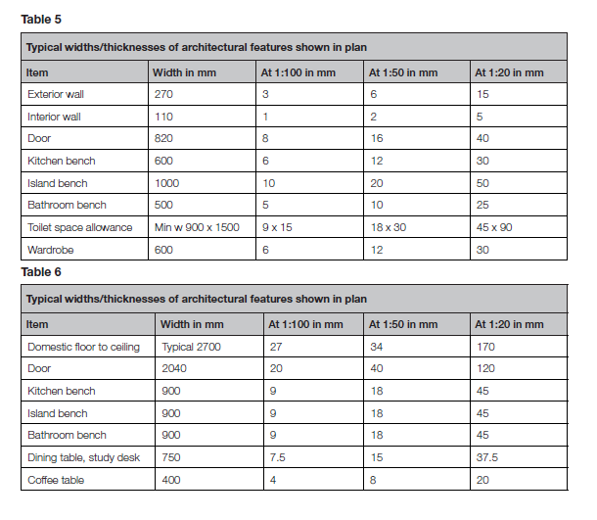
Source: VCE Technical Drawing Speciﬁcations

Slide 23
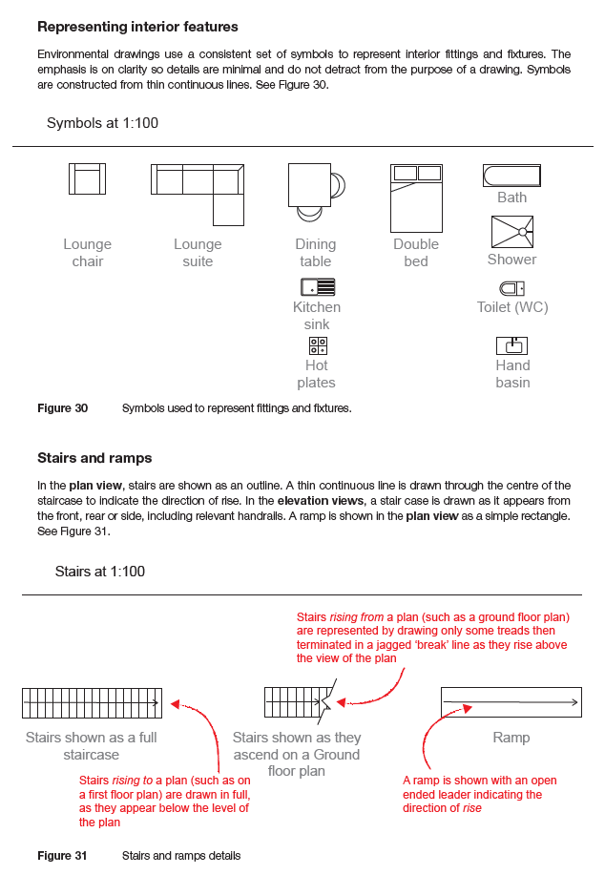
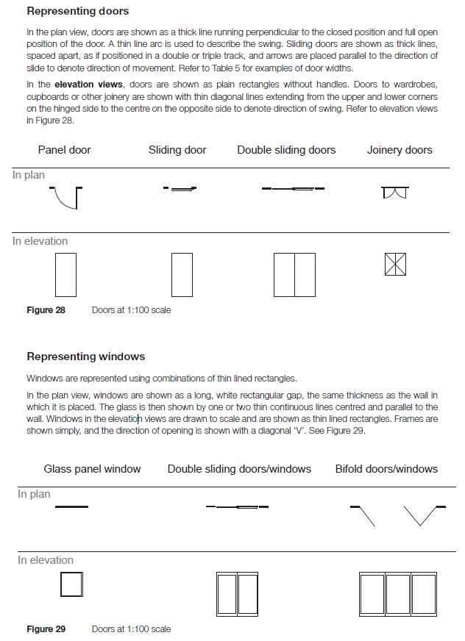
Source: VCE Technical Drawing Speciﬁcations

Slide 24
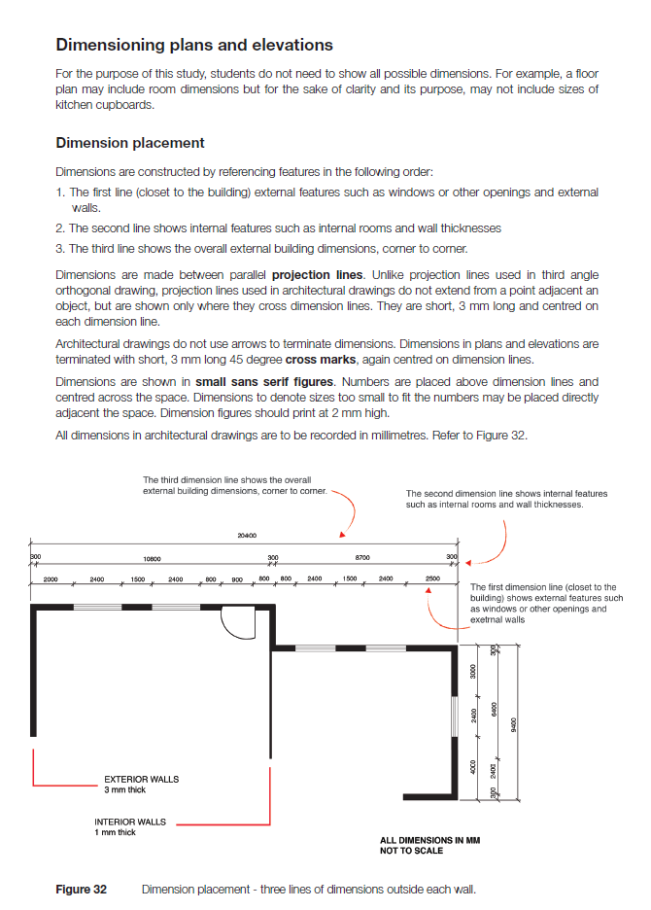
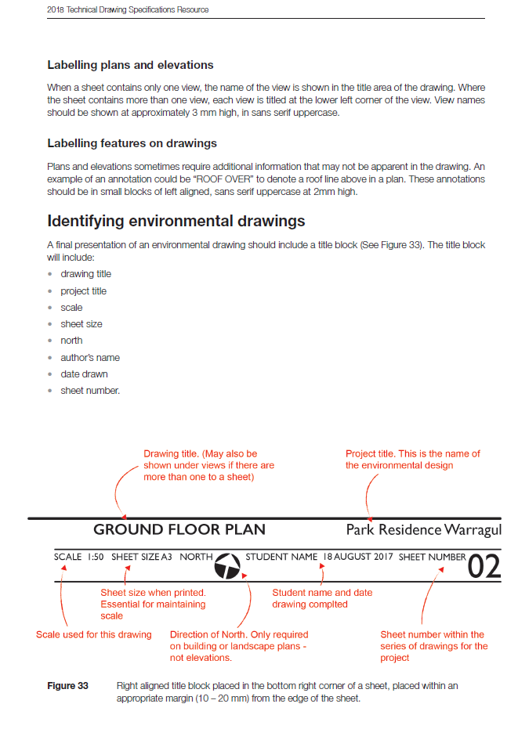
Source: VCE Technical Drawing Speciﬁcations

Slide 25
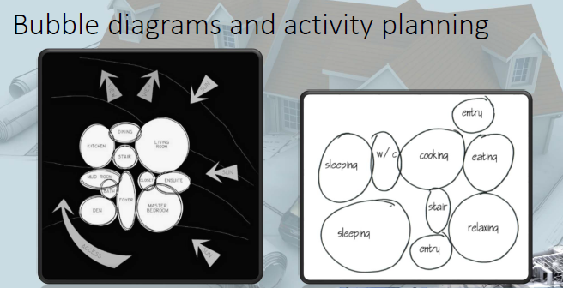
Steps of Setting Up a Floor Plan

Slide 26
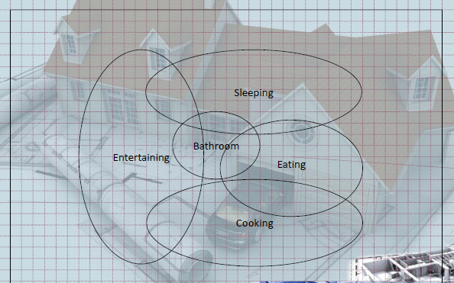
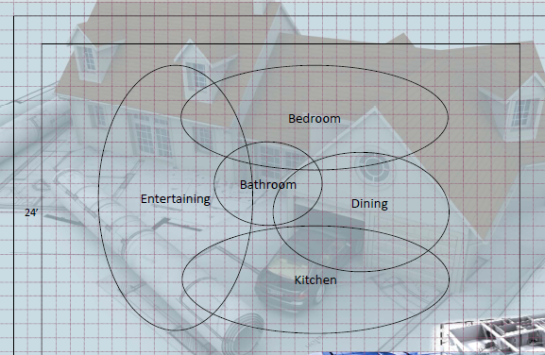

Slide 27
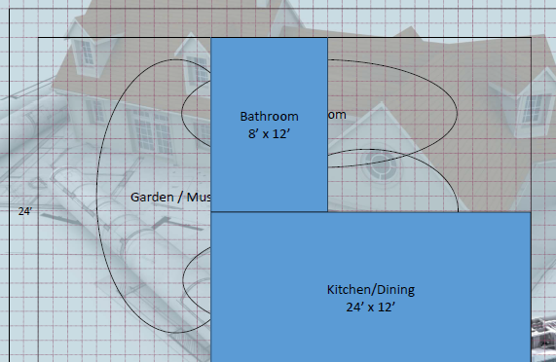
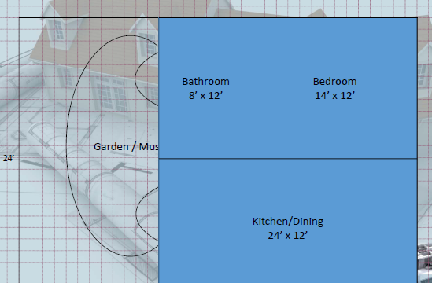

Slide 28



Slide 29


Slide 30

Steps of Documenting a Floor Plan
Setting up a floor plan can be done by hand or using digital software. However, for documentation, digital software is required.

Slide 31



Slide 32


Other Components in Floor Plan
Source: VCE Technical Drawing Speciﬁcations

Slide 33

Other Components in Floor Plan View

Slide 34


Other Components in Floor Plan View
Source: VCE Technical Drawing Speciﬁcations

Slide 35
Activity: Refine the Group Floor Plan

Slide 36
Reference
Zaha Hadid Architects. (2025). Zaha Hadid Archives. https://www.zaha-hadid.com/archive/?type=architecture
OMA. (2025). OMA Projects. https://www.oma.com/projects
Pinterest. (2025). Pinterest Image. https://www.pinterest.com/
Arch Daily. (2025). Arch Daily Image. https://www.archdaily.com/
Ching, F. (2023). Design Drawing. Wiley
Victorian Curriculum and Assessment Authority. (2018). Technical Drawing Specifications Resource: A guide to support VCE Visual Communication Design study design 2018–22. https://www.scribd.com/document/383339569/VCE-Technical-Drawing-Specs
Pinterest. (2025). Pinterest Image. https://www.pinterest.com/

Slide 37
Thank you
Questions?

